Slide 1
INDIAN SIGN LANGUAGE
TO
VOICE
Mentor
{
Ms. Haritha H.
};
Team Members
{
Martin Joseph Juneie,
Sandesh Sreeraj,
Sidharth K.K.
};

Slide 2
/*Contents*/
{
Motivation and Scope
Problem Statement
Literature Survey
Existing System
Proposed Methodology
Software Requirements
Hardware Requirements
Conclusion
References
}

Slide 3
/*Motivation and Scope*/
{
Communication is the process of exchange of thoughts and messages in various ways such as speech, signals, behavior and visuals.
Deaf and mute people make use of their hands to express different gestures to express their ideas with other people.
Gestures are the nonverbally exchanged messages and these gestures are understood with vision. This nonverbal communication of deaf and mute people is called sign language.
In this project we are focusing on converting Indian Sign Language to speech.
}

Slide 4
/*Problem Statement*/
{
To develop a communication approach for healthy people to understand sign language used by hearing impaired people with ease.
}

Slide 5
/*Literature Survey*/
Title | Author | Year | Advantages | Disadvantages | Methodology
American Sign Language to Text and Speech | Vi N.T. Truong Chuan-Kai Yang Quoc-Viet Tran | 2016 IEEE | Precision of 98.7%. Takes live video as input. | Only works on American Sign Language. | Haar for object detection. AdaBoost for feature collection.
Double Handed Indian Sign Language to Speech and Text | Kusurnika Dutta Satheesh Raju K. Anil Kumar G.S. Sunny Swamy B. | 2015 IEEE | Translates double handed sign language. Does not require data gloves. | Lack of precision. | Shi-Tomasi (Minimum Eigen Value) for corner detection. Image processing is performed in MATLAB.

Slide 6
Title | Author | Year | Advantages | Disadvantages | Methodology
Deaf Talk Using 3D Animated Sign Language | Mateen Ahmed Mujtaba Idrees Zain ul Abideen Rafia Mumtaz Sana Khalique | 2016 ACM | 2 way communication 87% precision for speech conversion. 3d simulation. | Does not convert into natural language. | AdaBoost produces an analogous result. Random Forest Regression machine learning algorithm.
Converting sign language to Mandarin-Tibetan cross-lingual emotional speech | Nan Song Hongwu Yang Tingting Zhang | 2018 IEEE | Detection of sign languages and emotions. 90.7% precision for sign. | Does not translate into English. | A deep neural network (DNN)-based framework. Support Vector Machine to classify sign languages.
IEEE Transactions on Neural Networks and Learning Systems | John Doe Jane Smith Mark Johnson | 2018 IEEE | 87% accuracy for converting into sign language . The system can be used in various settings. | Requires a large amount of training data to achieve high accuracy, which can be challenging to collect. | Convolutional Neural Networks (CNN) Recurrent Neural Networks (RNN) Support Vector Machines (SVM)

Slide 7
Title | Author | Year | Advantages | Disadvantages | Methodology
Sign Language to Emotional Speech Conversion by Deep Learning | Weizhe Wang Hongwu Yang | 2021 IEEE | Good gesture and facial expression recognition. | Limited availability of suitable datasets. Low real time performance. | DCGAN for gesture recognition and facial expression recognition. Hybrid LSTM to improve the quality of synthesized emotional speech.
Convolutional Neural Network based Bidirectional Sign Language Translation System | Lance Fernandes Prathamesh Dalvi Akash Junnarkar | 2020 IEEE | Bi directional translation. The accuracy is 99.98 percent as the data-set was made versatile. Several new gestures can be added by training the model with new required datasets. | Incorrect use of various electronic components tend to destroy the whole system. Requires additional hardware. | The flex sensor and accelerometer values on the glove change according to the gesture made.

Slide 8
/*Existing System*/
{
Currently there exists sign language to speech converters only for American Sign Language which is able to only solve a subset of the sign language conversion problem.
There exists a plethora of sign languages prominent in various regions.
Existing systems implements finger spelling translators, however, sign languages are also spoken in a contextual basis where each gesture could represent an object or verb.
Other issues include lack of detection accuracy because of the system not being trained with enough samples.
}

Slide 9
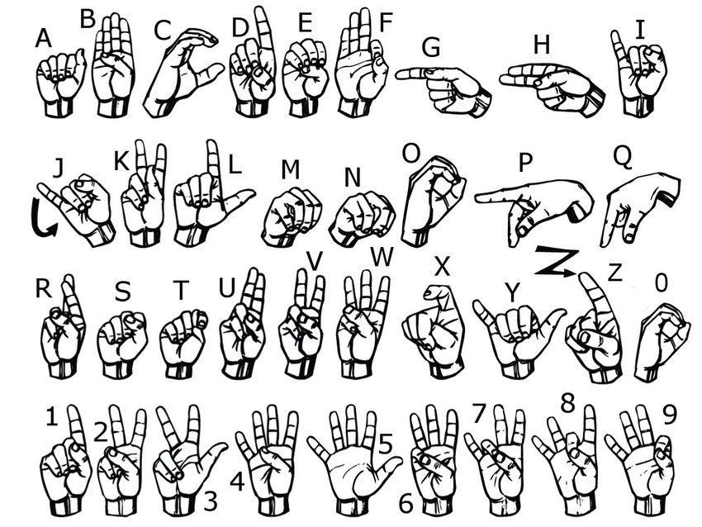
/*American Sign Language*/

Slide 10
/*Proposed Methodology*/
{
1. Creating dataset for training and testing.
Capturing each frame.
Defining a Region of Interest (ROI).
Applying Gaussian blur.
2. Using Convolutional Neural Network (CNN) for building a training model.
Network will learn filters that activate when they see some type of visual feature such as an edge of some orientation or a blotch of some colour.
3. Creating a GUI to convert signs into text.
UI shows the captured sign and the recognised symbol. At the same time, it appends the recognised character to a string and converts it into voice after termination of the string.
}

Slide 11
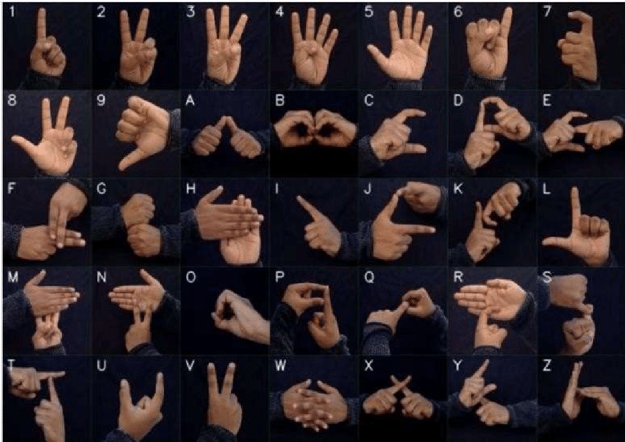
/*Indian Sign Language*/

Slide 12
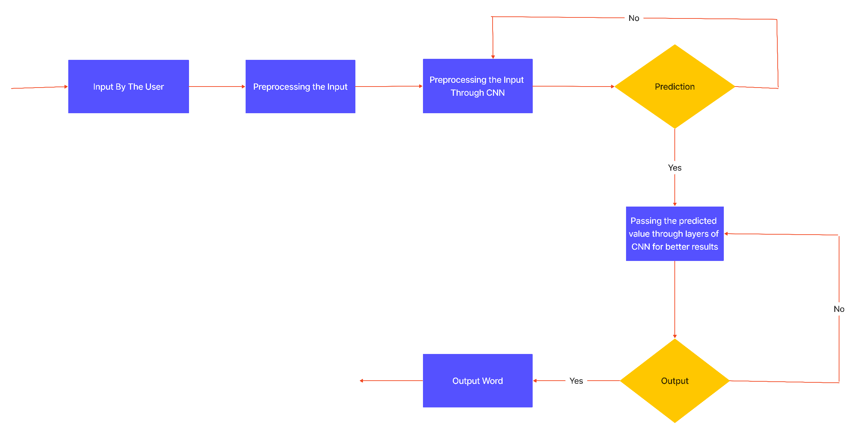
/*System Design or Architecture*/

Slide 13
/*Hardware Requirements*/
{
The system can run only on computers, as mobile devices have very limited computational power.
To recognize signs the system requires a camera interface or image sensor available on the host device.
A minimum of 8 GB ram will be required for all the computation to be performed.
}

Slide 14
/*Software Requirements*/
{
The below software interfaces are required to run the program:
Python
NumPy
OpenCV
MediaPipe
TensorFlow
}

Slide 15
/*Conclusion*/
{
The project is a simple demonstration of how CNN can be used to solve computer vision problems.
Indian Sign Language is used in various Southern Asian regions, thus an Indian Sign Language converter eliminates the need for an external interpreter.
The project can be extended to other sign languages by building the corresponding dataset.
}

Slide 16
/*References*/
{
[1] Vi N.T. Truong, Chuan-Kai Yang, Quoc-Viet Tran, “A Translator for American Sign Language to Text and Speech”.
[2]Kusurnika Dutta ,Satheesh Raju K,Anil Kumar G.S,Sunny Swamy B.
“Double Handed Indian Sign Language to Speech and Text”.
[3]Nan Song,Hongwu Yang,Tingting Zhang “Deaf Talk Using 3D Animated Sign Language ”
}

Slide 17
printf(“Thank You”);

